Slide 1
HANKEN’s programmes in english
Name
Date

Slide 2
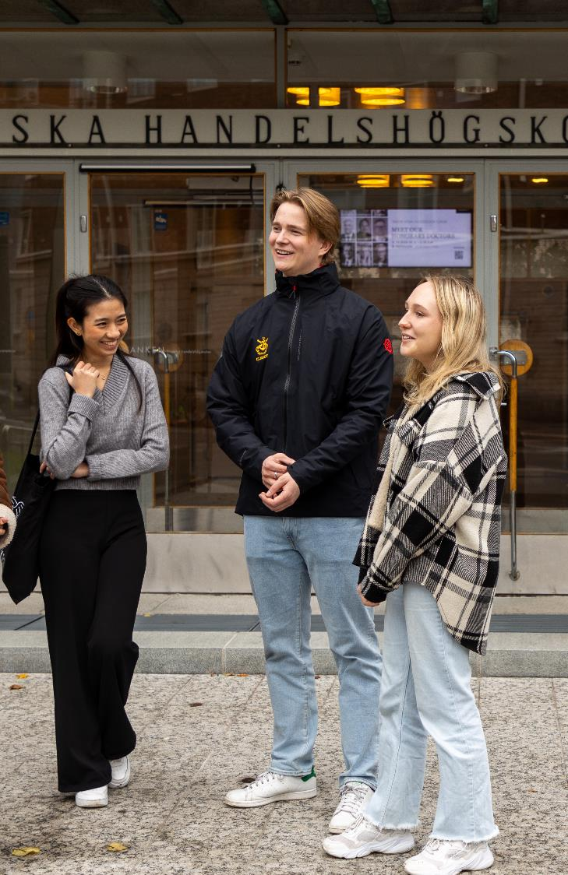
COntents
This PowerPoint presentation can be used for student recruitment for upper secondary school students or students from other universities.
Please use the slides you need and remove the rest, for example, if you are presenting the bachelor’s programme, hide the master’s slides. Fill in information about who you are and what the agenda is.
Note! Do not change the information provided about Hanken or Hanken’s degree programmes.
Content:
Introduction slides
General information about Hanken
Degree programmes and structure
The Swedish taught Bachelor’s programme
The Bachelor in Business programme in English
The Master’s programme
The Double Degree Master’s programme

Slide 3
HANKEN SCHOOL OF ECONOMICS

Slide 4
WHO AM I
Name
Main subject
Any minors
Year of study
About me
Before Hanken, e.g. went to X for high school, graduated in 2022
I am active in the student union/association in committee X
I work as X at Y
Any other interesting info?
Insert a picture of yourself

Slide 5

TODAY’S AGENDA
Please create an agenda for the presentation
For example →
Why Business?
Why Hanken?
Student life at Hanken
How do you apply to Hanken?

Slide 6
Information about hanken

Slide 7
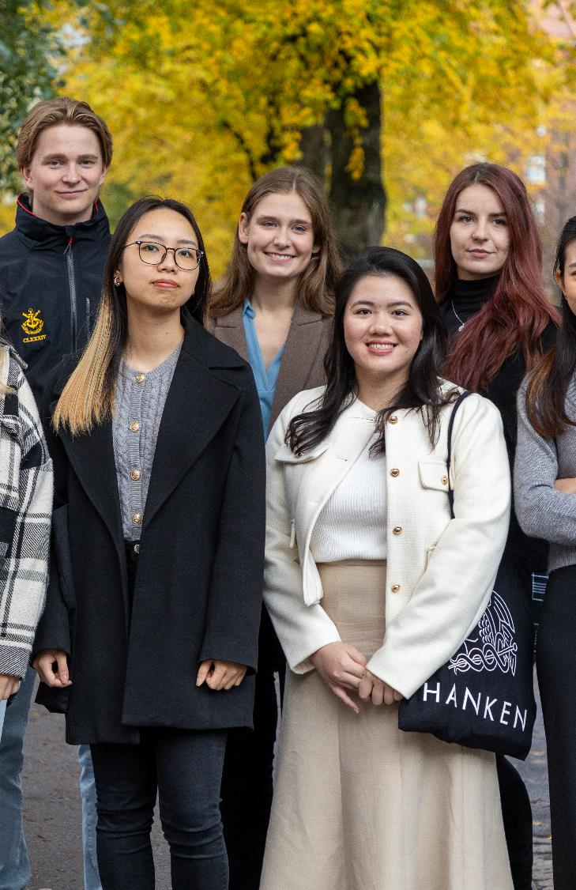
HANKEN
Hanken is the only independent business school in Finland and one of the oldest business schools in the Nordic countries
We focus all education and research exclusively on business and economics
A highly ranked, valued and international business school
Triple accredited: EQUIS, AACSB & AMBA
Top 1% of business schools worldwide
2 815 students (2024)
2 690 BSc and MSc students
125 PhD students
20% in the Vaasa campus
If you apply to BSc you are automatically also entitled to continue with your MSc at Hanken
A member of the ENGAGE.EU university alliance with 8 other universities + 1 associated university

Slide 8
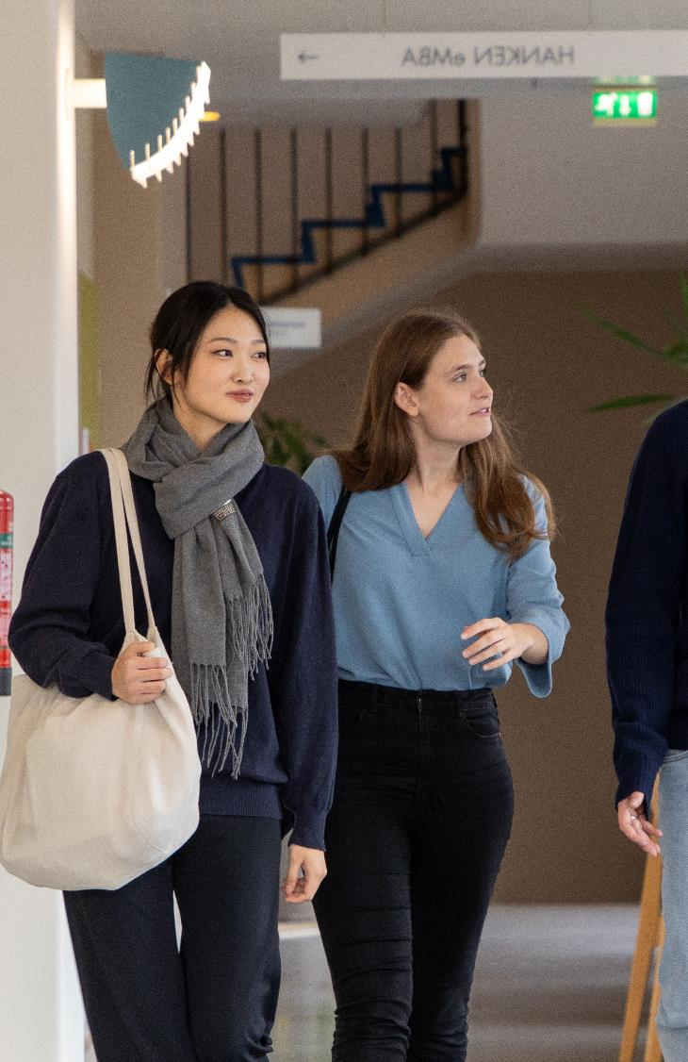
HANKEN – unique features
Hanken #1 among universities in Finland in terms of graduates’ satisfaction with their MSc studies (2023)
All BSc students have an opportunity to go on exchange to a foreign university or do an internship abroad
Start-up activities in the Hanken Business Lab
A startup incubator that provides growth-oriented support services to its resident startups and entrepreneurs through mentoring, workshops and community-building activities
35+ courses at Hanken have an integrated sustainability part
Investment in student well-being services
Hanken’s support services are an important part of students’ everyday life: study coaching, study psychologist, and psychotherapy

Slide 9
HANKEN – unique features
Hanken is a small business school, which means the sense of belonging and community is unique
Our alumni appreciated the community so much that they want to give back to those studying now
Close connection to the business world
The business world is also reflected in the teaching: our partner companies participate through, for example, real cases, guest lectures, company visits, and more
>40 % of the research tenure track professors international
The HUMLOG Institute (with the Finnish National Defence University) a world leader in humanitarian logistics, working closely with the UN and international organizations
Strong support from alumni and other supporters ➔ fundraising an integrated part of the financial model

Slide 10
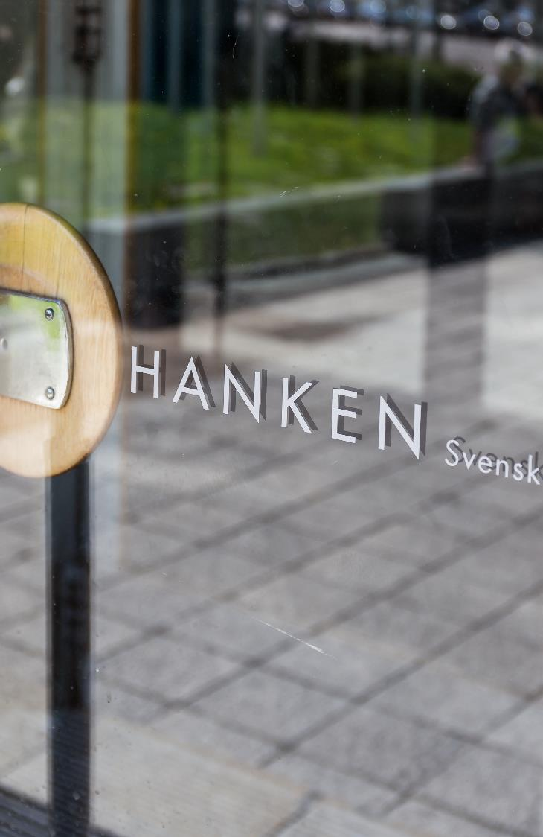
SELECTED RECENT ACHIEVEMENTS
Global rankings (2025)
Financial Times, Masters in Management: #60 globally, #3 in the Nordic countries
Education
Record number of applications (all levels) in 2024
Hanken has the most popular English speaking Bachelor in Business program in Finland (applications 2025)
Hanken #1 among universities in Finland in terms of graduates’ satisfaction with their MSc studies (2023)
Research
Highest scientific impact (‘Top 10 index’) of the Finnish universities (2018-21 publications, Vipunen 28.1.2025)

Slide 11

VERSATILE EDUCATION
The high-quality education at Hanken provides you with relevant and useful tools to operate in a changing world
You can choose between more mathematical subjects, more humanities subjects, or creative subjects
Digital solutions, AI, information processing, and coding are an important part of Hanken’s course offerings
Skills that can be adapted to you as a leader, employee, or entrepreneur
Hanken values language skills highly and offers a wide range of language courses through our language center
Hanken integrates sustainability and responsibility as an essential part of the education: 35+ courses

Slide 12

BUSINESS STUDIES
Field of Knowledge
Business studies provide you with a broad perspective that benefits both yourself and the companies you work for or establish
Career Opportunities
All companies, regardless of industry, need economists
Fashion, finance, environment and sustainability, charity, technology, healthcare, culture, real estate, media, transport, trade, etc.
In Finland or Abroad
22% of Hanken alumni work in 70 different countries
Business studies do not bind you to a specific country
Through our integration programme, that include local language studies, we aim that a significant number of the graduates build a life in Finland

Slide 13
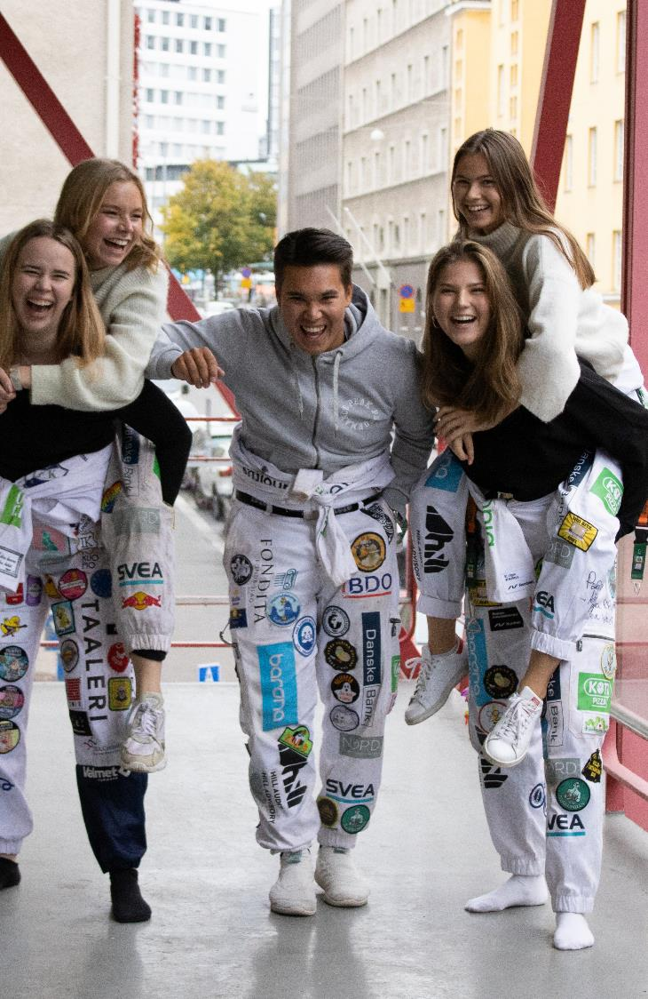

STUDENT LIFE AT HANKEN
All new Hanken students automatically become members of SHS
SHS looks after its students' interests towards the university and society, ensuring everyone has an unforgettable student life
Participate in events several times a week: sports, parties, culture, advocacy and company visits
Get involved in our committees and clubs
The Fresher’s committee is responsible for the tutor activities for the Bachelor programme in English
Hanken accepts exchange students every fall and winter
The Exchange and Master’s committees organize many events where you can meet new friends from around the world

Slide 14

STUDY IN FINLAND
Finland is the “happiest country in the world”
According to the World happiness report
All four seasons: endless days in Summer and snowy Winters
Most digitally advanced country in the EU
Affordable student housing
Hanken’s appartments in Arabia and in Jätkäsaari
Student discount with the Frank app
Affordable school lunch at 2,8EUR

Slide 15

STUDY IN HELSINKI
Helsinki is the world's third best city to live in and the safest city in the world
A hub of innovative design, rich culture, and amazing culinary experiences
A vibrant capital yet small and familiar, with affordable and efficient public transportation
A perfect city for studies: a large selection of libraries, UNI cafés with affordable lunch, affordable student housing, over 30K students live in the city, exciting student parties and events

Slide 16
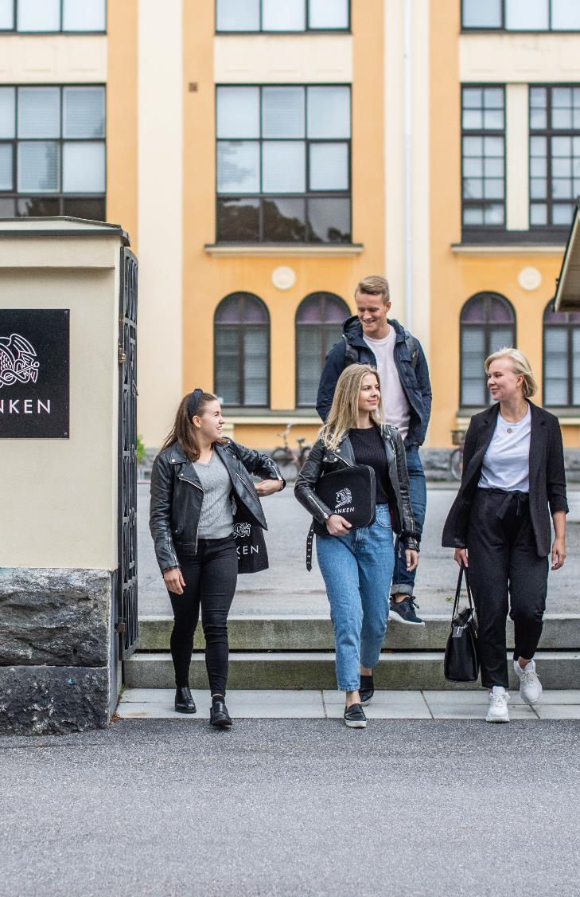
Study in Vaasa
Vaasa is a charming coastal city known for its stunning archipelago and clean air
A center of renewable energy innovation, rich historical heritage, and delightful culinary scenes
A vibrant and welcoming city with a small-town feel, offering efficient public transportation
An ideal city for students: numerous libraries, affordable UNI cafés, cost-effective student housing, a thriving student community with over 12K students, and lively student events and activities

Slide 17
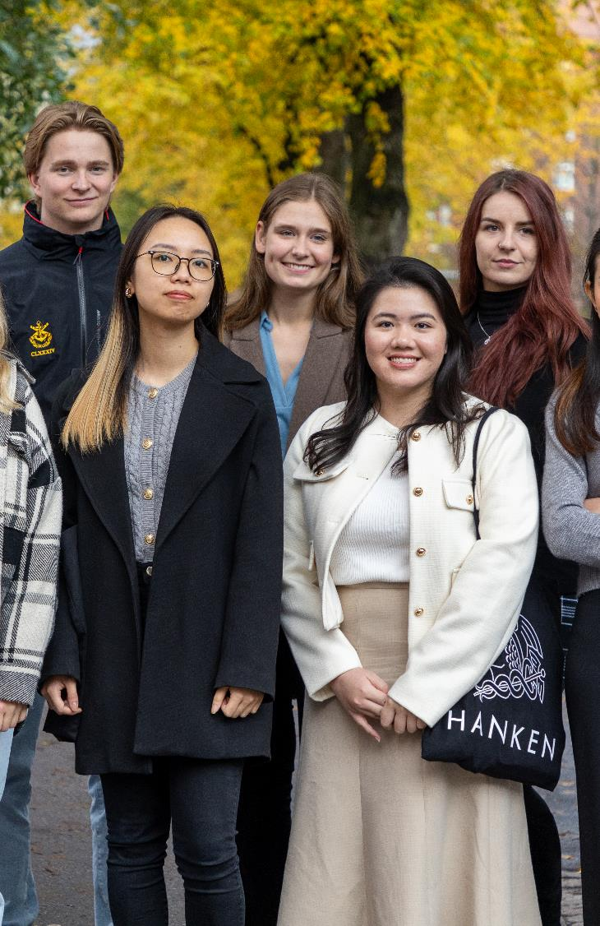
Truly international
The only business school with a mandatory exchange semester – ensuring international exposure for all students
200 exchange students come to Hanken every year and leave as ambassadors – 98% would recommend their experience
We have an increased number of international students. Through our integration programme, that include local language studies, we aim that a significant number of the graduates build a life in Finland
Integration module offered to support integration for International Bachelor in Business students (pilot academic year 2025-2026)​
We are increasing collaboration with the Finnish corporate world, thereby supporting their international competitiveness

Slide 18
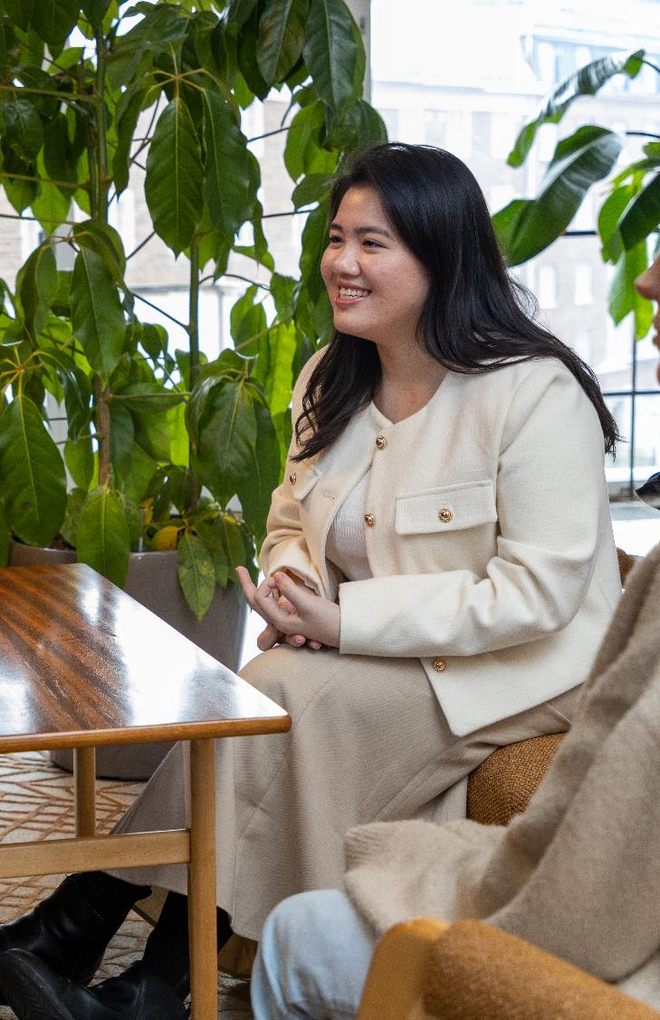
Exchange
The bachelor’s degree includes a mandatory stay abroad in the form of studies or an internship
Within the bachelor's programme in English, the stay abroad can be replaced with an integration study module on certain grounds
The exchange is based on reciprocal bilateral agreements with the partner universities
Hanken has over 100 partner universities across the world:
In Europe, Africa, America, Asia and Oceania
Hanken attracts students from the partner universities and Hanken is welcoming exchange students from many countries and partner universities each year

Slide 19



Exchange experiences
Hong Kong had everything I could wish for during my exchange - unbeatable exchange community, a beautiful and large campus in the heart of the city, a vibrant and lively metropolis, and beautiful nature with beaches and mountains Ville Ruokonen about The Hong Kong Polytechnic University
For me, exchange in Lugano was an incredible experience! Both experiencing living in a new country and meeting all the wonderful people are things I will remember forever! Being able to explore both Switzerland and Italy was a great advantage in Lugano, and it led to many fun trips!
Frida Winberg about USI Università della Svizzera Italiana
My time in Montreal was fantastic, and the city remains my second home to this day. Montreal is a vast metropolis that offered both culture (primarily through its languages and history) and vibrant life amidst incredible nature. The university's exchange committee organized weekly events and trips, both within Canada and abroad. The amazing people I met from all corners of the world have given me lifelong friends, and I am forever grateful for the experience!
Nicolina Rosvall about HEC Montréal

Slide 20

A pedagogy that helps foster responsible professionals and well-balanced individuals
New pedagogic guidelines introduced​
Focus on campus-based education and experiential learning
Integration module offered to support integration for International Bachelor in Business students (pilot academic year 2025-2026)​
Investment in student well-being services
Navigator programme in Bachelor in Business and Swedish speaking programmes to help students create a solid base for sustainable performance and well-being

Slide 21
Degree programmes and structure

Slide 22
DEGREE PROGRAMMES
Bachelor’s programmes (12 000 euros/year for non-EU students +2 years Master’s)
The “Swedish” programme (revised 2025): Basic courses taught in Swedish, other courses in Swedish or English (Helsinki & Vaasa campuses), 300+ students per year (including 10-20 from Sweden)
Bachelor in Business programme taught in English, 2024- (Helsinki campus), 80 students
Master’s programmes (15 000 euros per year, 2 years; except one 1-year programme)
BSc students continuing their studies + separate enrolment in programmes in English and Swedish (Helsinki & Vaasa campuses), 200-250 students
New one-year Master’s programme ‘Financial Analysis and Sustainability Reporting’ jointly with Umeå University, 2025- (Vaasa campus), target: 60 students
New one-year Master’s module/programme in ‘Global Sustainability Management’ with the partners in ENGAGE.EU, 2025/26- (Helsinki campus), 10-20 students from Hanken
PhD programme (financial support, 4 years)
Tuition mainly in English (Helsinki & Vaasa campuses), approximately 20 students per year

Slide 23
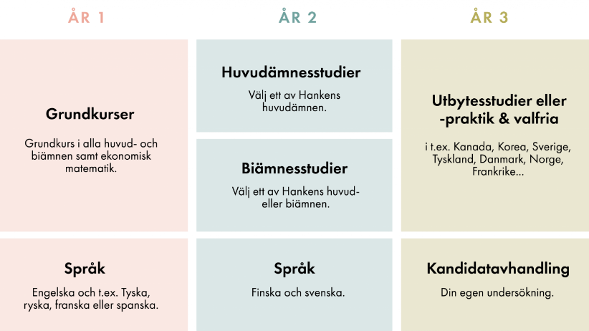
THE SWEDISH TAUGHT BACHELOR’S PROGRAMME
The majors you can choose from:
Marketing
Accounting
Finance
Economics
Management and entrepreneurship
Management and organisation
Commercial law
Additional minors:
Supply chain management and social responsibility
(Can become a major on Master’s and PhD level only)
Information technologies
Statistics
Languages:
Swedish
Finnish
English
German
French
Spanish

Slide 24

APPLICATION TO THE SWEDISH PROGRAMME
10-24.3.2026
Hanken in Helsinki and Vaasa are two separate application options in the second joint application of the spring. You can apply to one or both locations.
70% are admitted based on school grades & 30% based on entrance exam.
Applications are submitted via the Studyinfo portal in March
Application with matriculation examination or entrance exam (only for Swedish programme)

Slide 25
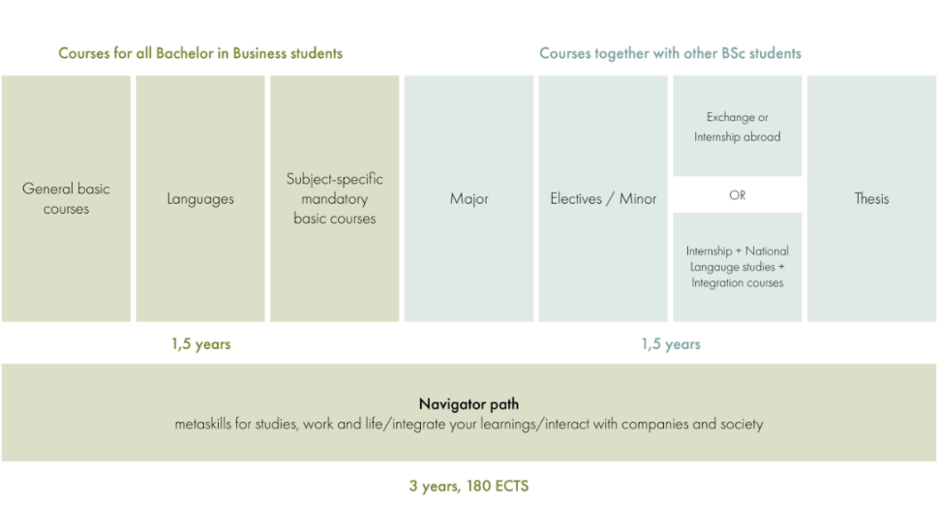
The bachelor in business programme

Slide 26
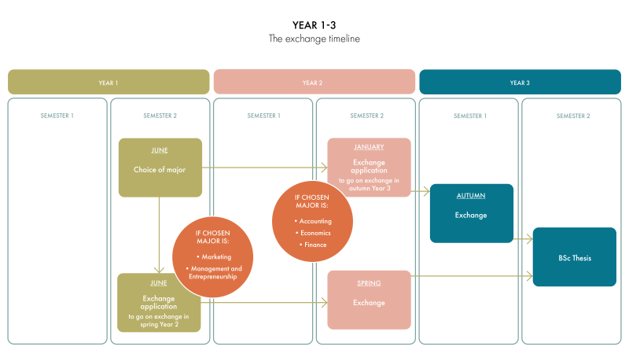
EXCHANGE TIMELINE AND SUBJECTS
The majors you can choose from:
Marketing
Accounting
Finance
Economics
Management and entrepreneurship

Slide 27
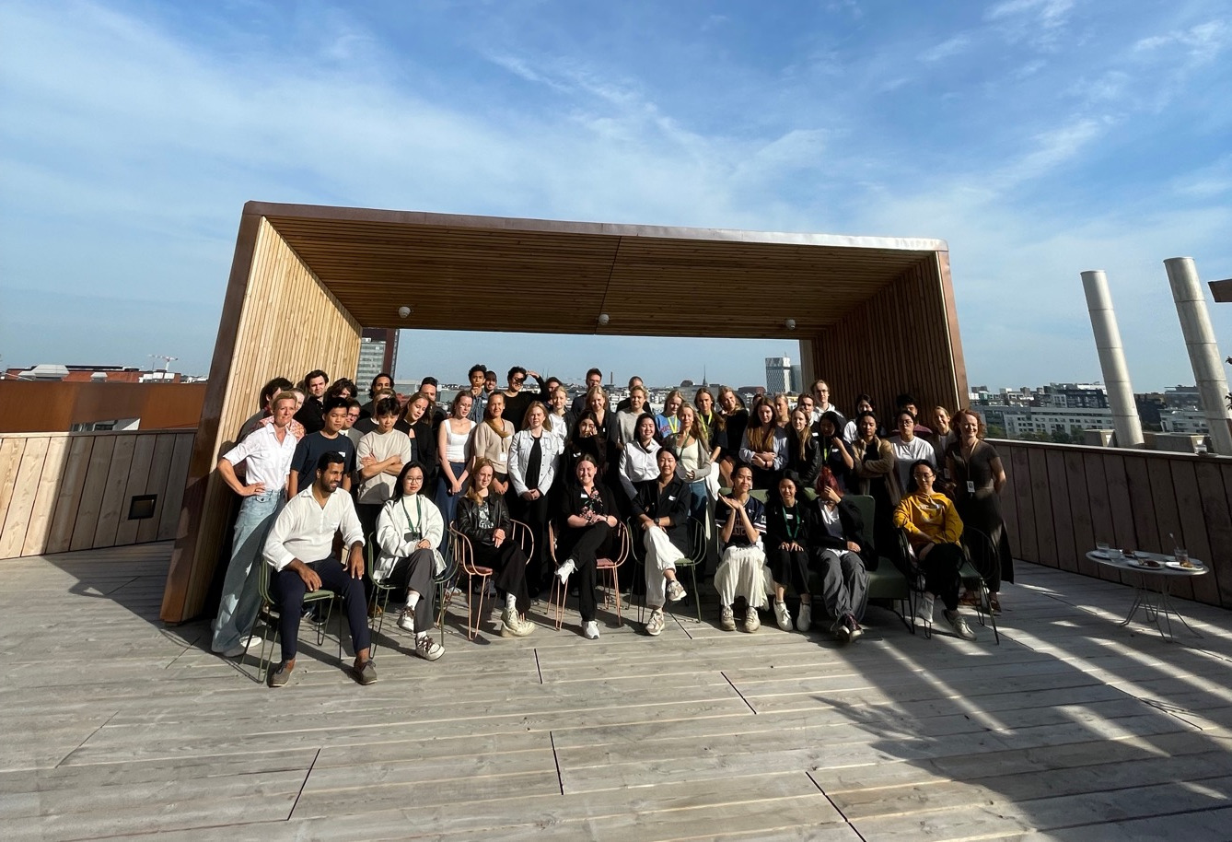
NAVIGATOR PATH
Metaskills for sustainable performance and well-being
Hanken Bachelor in Business 2024-2025

Slide 28
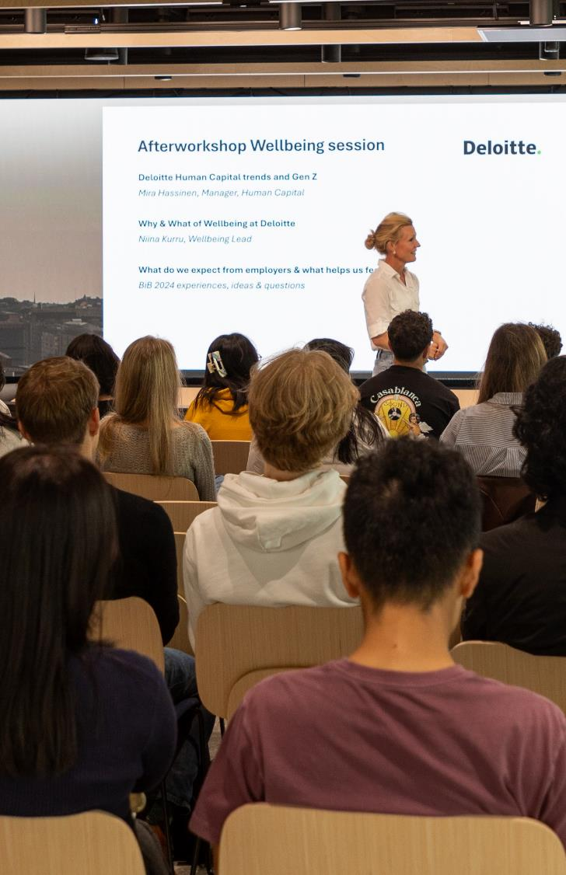
THE NAVIGATOR PATH
A unique initiative offering a development journey through three mandatory courses over 1,5 years. It gives Hanken students access to the tools, coaching, structured reflection and guided peer support that most gain access to only when they are singled out as top talent, become managers, attend an MBA or experience a burnout. Piloted as part of the new Bachelor in Business programme starting 2024.

Slide 29
THE NAVIGATOR PATH Three key learning goals to build three key metaskills
Society
LEARNING GOALS
METASKILLS
Work
1. Understanding and leading myself
1. Self-awareness and leadership
Others
2. Interacting and collaborating for impact
Me
2. Interpersonal skills
3. Thriving through change and adversity
3. Resilience
Studies
Notes:
Previous:

Slide 30


APPLY to Bachelor in Business
7-21 January 2026 until 3 pm (GMT+2)
The application period for the programme is in January for the study start in autumn the same year.
60% of new students admitted based on SAT/ACT and 40% will be admitted based on certificates (Finnish matriculation examination, International Baccalaureate, European Baccalaureate or Reifeprüfung/Deutsches Internationales Abitur certificate completed in Finland).
SAT min. 1100, ACT min. 22

Slide 31
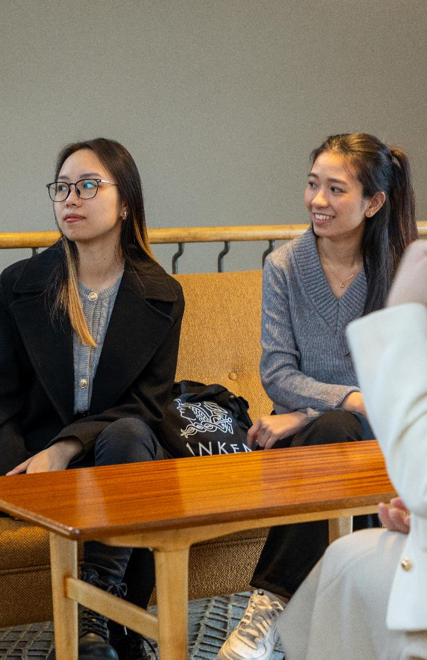
MASTER FROM HANKEN
Duration: 2 years of full-time studies
Language of instruction: English
Mode of study: on site
Study location: Helsinki or Vaasa
Degree awarded: Master of Science in Economics and Business Administration

Slide 32

PROGRAMMES
The majors you can choose from:
Accounting
Economics
Finance
Governance and Commercial Law
Humanitarian Logistics
International Strategy and Sustainability
Marketing
Marketing and Management
Intellectual Property Law
GSM module within the programme International Strategy and Sustainability (ENGAGE.EU cooperation).

Slide 33
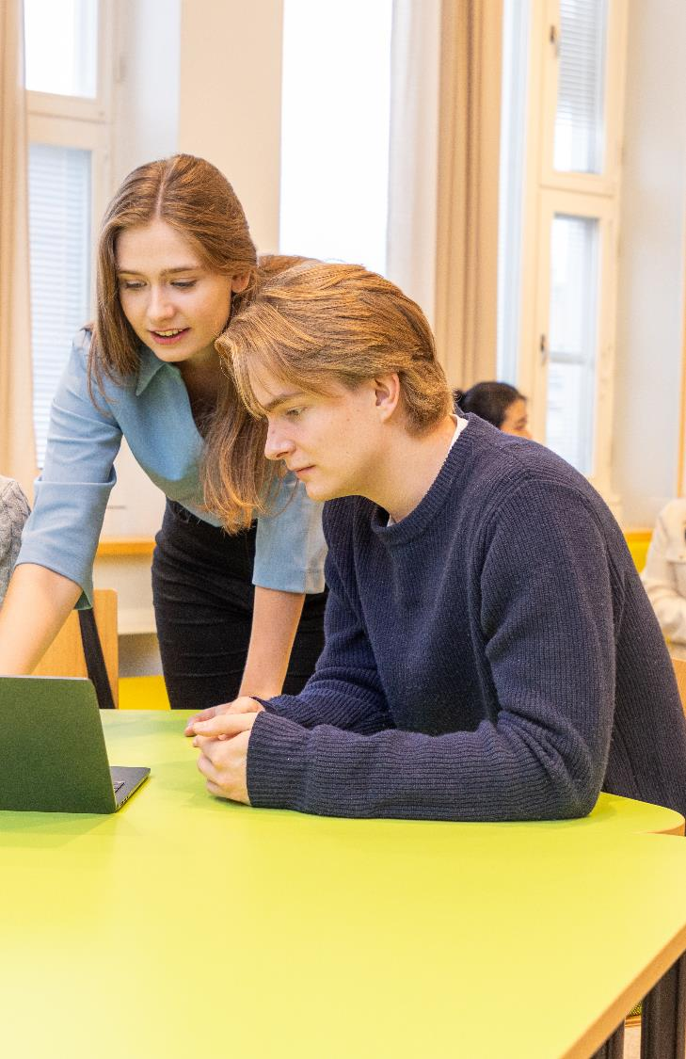
APPLY
Main admission criteria:
Bachelor’s or master’s degree from a recognised university or a university of applied sciences
Language requirement, the relevant tests listed here.
At least 30 ects in subjects relevant for the particular programme
GMAT or GRE admission test or gpa requirement (3)
CV in English

Slide 34
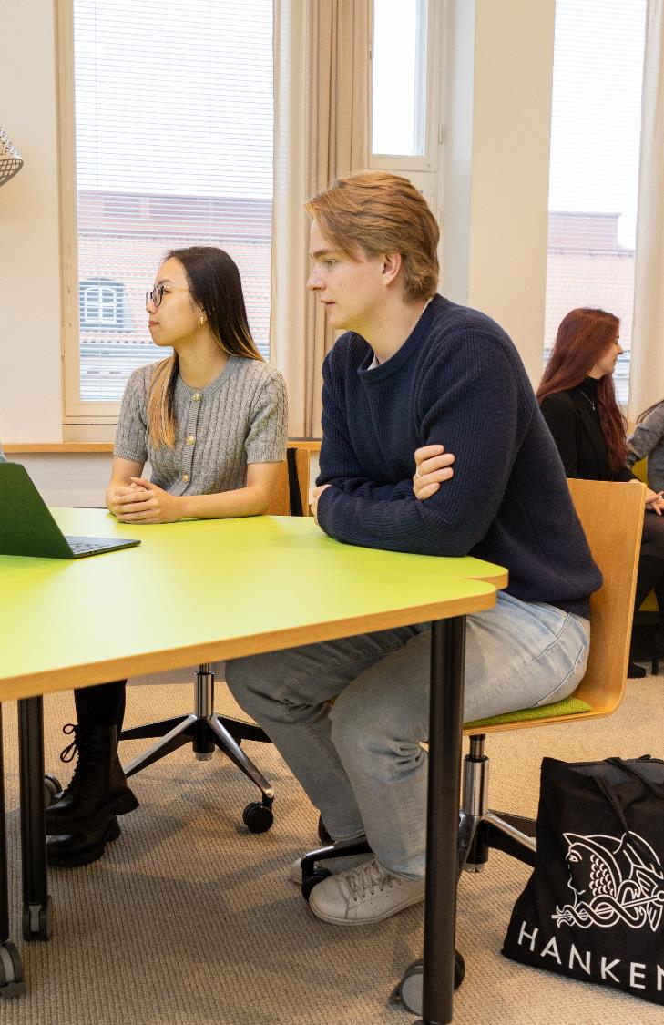
APPLY TO MASTER’S
Application period
7-21 January 2026 until 3 pm (GMT+2)
The application is part of the first joint application 2026
You can apply to a maximum of 6 study programmes in Finland which are part the joint application
You can apply to a maximum of 2 MSc programmes at Hanken

Slide 35
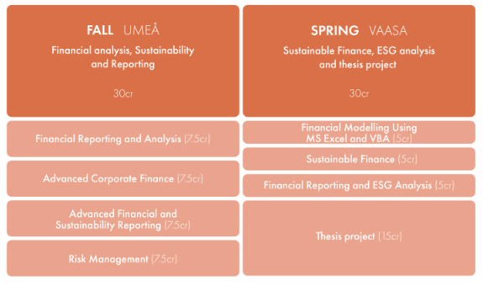
Master's Double Degree Programme in Sustainability Reporting and Financial Analysis
Hanken School of Economics in Vaasa together with Umeå School of Business, Economics and Statistics (USBE)
The first one-year master's programme by a university or business school in Finland
The programme will be taught full time in English, full-time and on-site in both Umeå and Vaasa
Degrees from both universities

Slide 36
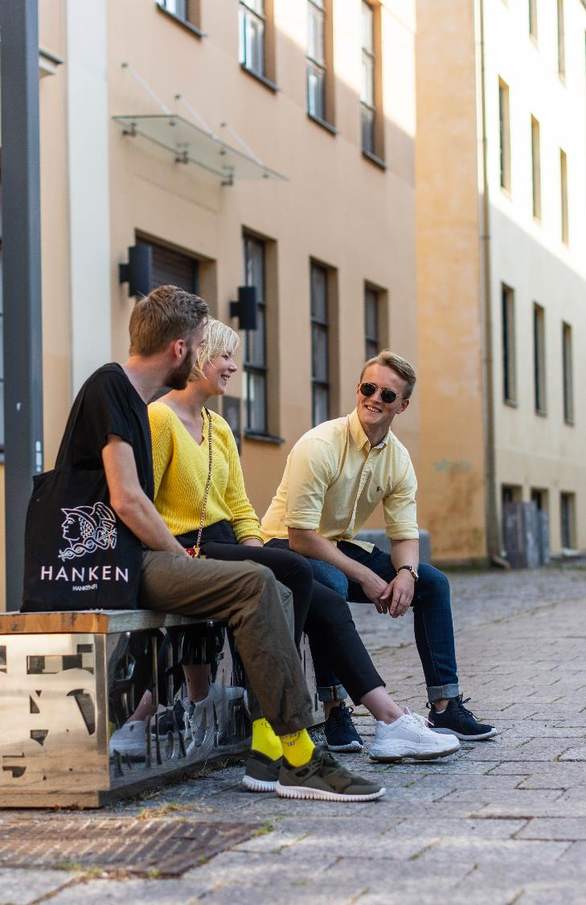
APPLY
Application period for internationals (non-EU):
15.10.2025 – 16.1.2026
Application period for internationals (EU) and nationals:
16.3 – 15.4.2026
Read more about the admission on USBE’s webpage.

